Slide 1
AI-assisted Intrusion Detection

Slide 2
Content
What system logs look like
Limitation of traditional method
How machine learning method helps intrusion detection
Hands on experiments

Slide 3
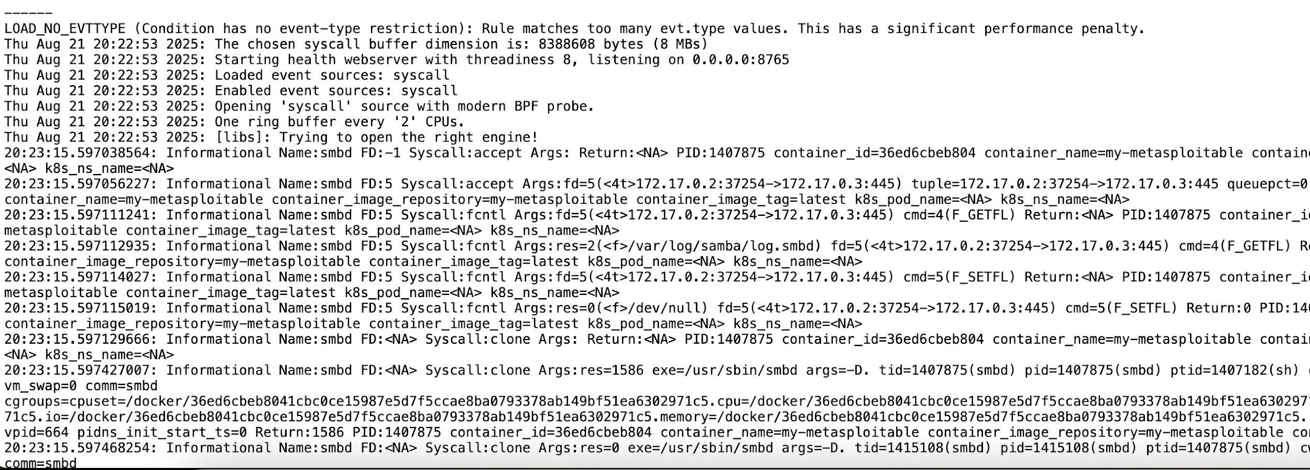
What system logs look like
It can be raw system-level logs

Slide 4
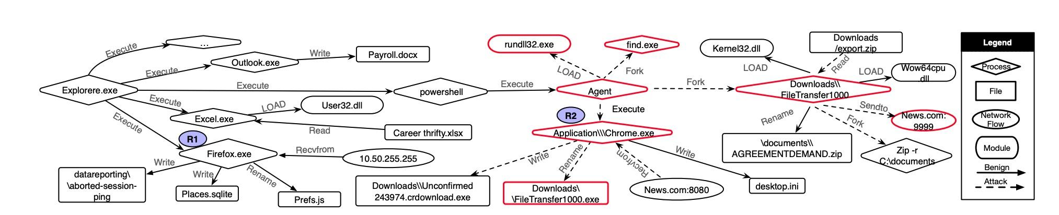
What system logs look like
It can be provenanced-based logs

Slide 5
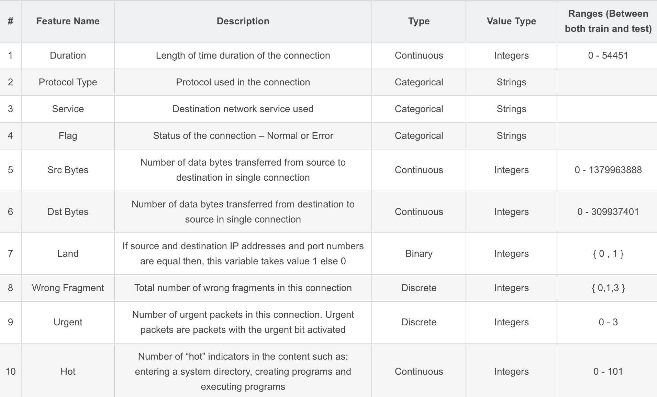
What system logs look like
It can also be manually labeled

Slide 6
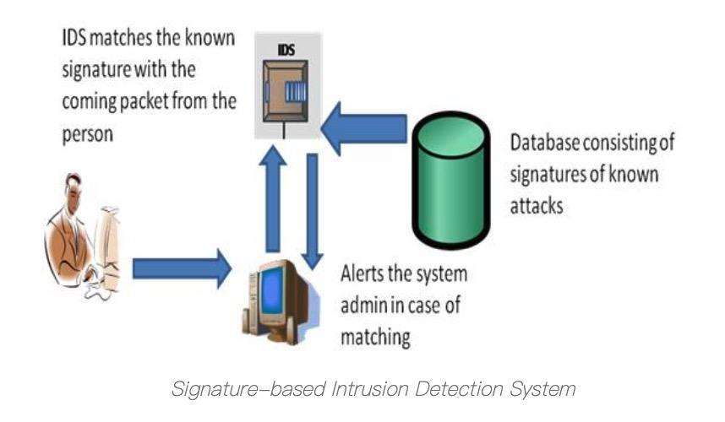
Limitaion of traditional method
Pattern based, signature based
Rely on manually defined attack signatures
→ Only effective for known attacks
Easily evaded by attack variants or obfuscation
→ Small changes in payload can bypass detection
High maintenance cost for rule updates
→ Requires continuous expert intervention
Poor generalization to new systems or environments
→ Rules do not transfer well across deployments
Notes:
Signature-based Intrusion Detection System: This system works on the principle of matching. The data is analyzed and compared with the signature of known attacks. In case of any matching, an alert is issued. An advantage of this system is it has more accuracy and standard alarms understood by the user.

Slide 7
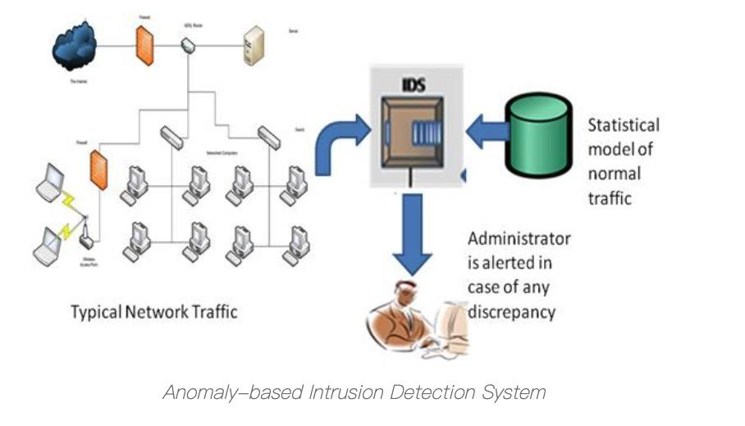
Limitaion of traditional method
Anomaly based
Depend on an accurate model of “normal behavior”
→ Hard to define in real-world systems
High false positive rate
→ Rare but benign behaviors are flagged as attacks
Sensitive to system and workload changes
→ Updates and configuration changes break assumptions
Thresholds are often manually tuned
→ Unstable and environment-specific
Notes:
Anomaly-based Intrusion Detection System: It consists of a statistical model of normal network traffic which consists of the bandwidth used, the protocols defined for the traffic, the ports, and devices that are part of the network. It regularly monitors the network traffic and compares it with the statistical model. In case of any anomaly or discrepancy, the administrator is alerted. An advantage of this system is it can detect new and unique attacks.

Slide 8
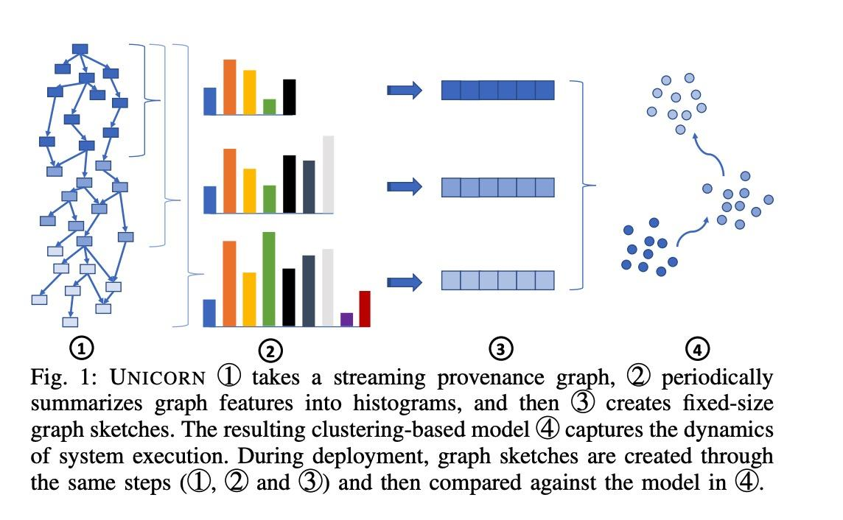
How machine learning method helps IDS
Automatically learn patterns from data
→ Reduce reliance on hand-crafted rules
Handle high-dimensional and multi-source logs
→ System calls, processes, networks, provenance, etc.
Better generalization to unseen attacks
→ Detect behavior patterns rather than exact signatures
Support diverse models and representations
→ ML (LR, RF) and DL (CNN, GNN for sequences and graphs)

Slide 9
Hands on experiments
task1: explore nsl-kdd datasets
task2: feature extraction
-- how to handle multiple features labeled
-- how to parse raw system logs into graphs
task3: model choosing
-- machine learning: Logistic Regression, Decision Tree, Random Forest, ...
-- deep learning: CNN, GNN, ...

Slide 10
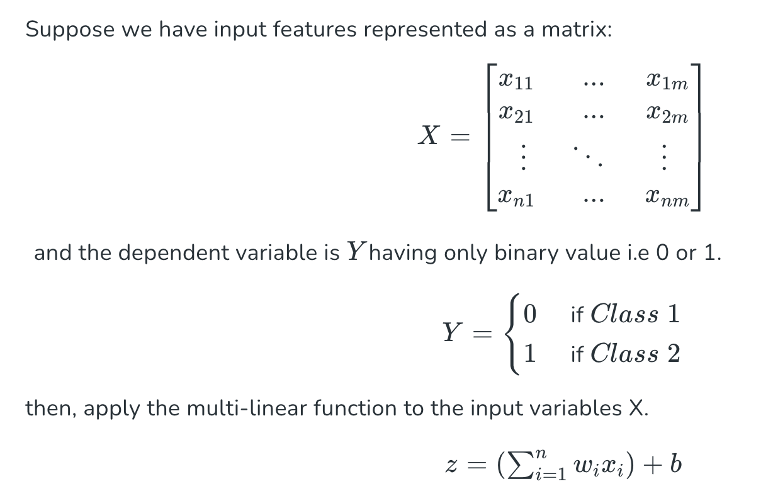
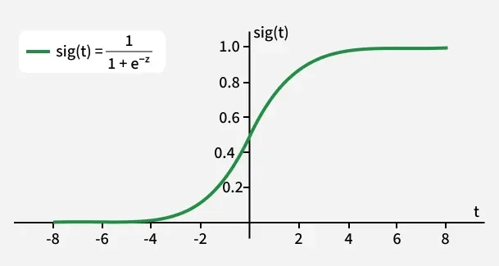
Logistic Regression
Notes:
“We represent our input features as a matrix XXX, where each row corresponds to one data sample, and each column corresponds to one feature.”
“So if we have nnn samples and mmm features, XXX is an n×mn \times mn×m matrix.”
“The dependent variable YYY is binary — it only takes values 0 or 1.”
“In practice, we usually interpret:
0 as the negative class
1 as the positive class”
“Our goal is to predict the probability that Y=1.”
“Here comes the key difference.”
σ(z)=11+e−z\sigma(z)=\frac{1}{1+e^{-z}}σ(z)=1+e−z1​
“We pass the linear output zzz through a sigmoid function.”
“The sigmoid function maps any real number into a value between 0 and 1.”
“This is important because it allows us to interpret the output as a probability.”
👉 Highlight:
“When zzz is very large, the output is close to 1. When zzz is very small, the output is close to 0. And when z=0, the output is exactly 0.5.”

Slide 11
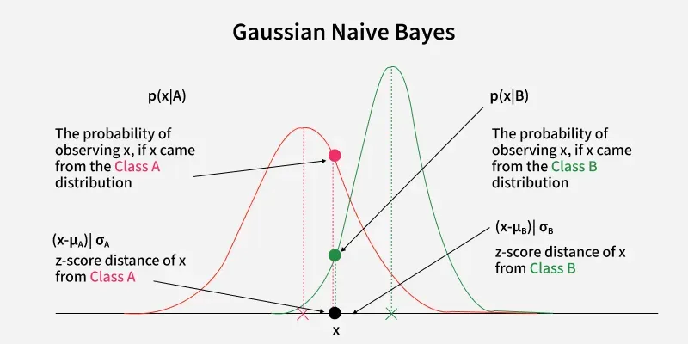
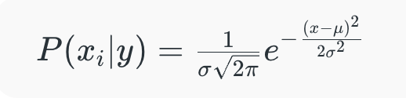
Gaussian Naive Bayes
Notes:
x
i
​
is the feature value,
μ
μ is the mean of the feature values for a given class
y
k
y
k
​
,
σ
σ is the standard deviation of the feature values for that class,
π
π is a constant (approximately 3.14159),
e
e is the base of the natural logarithm.
To classify each new data point x the algorithm finds out the maximum value of the posterior probability of each class and assigns the data point to that class.

Slide 12
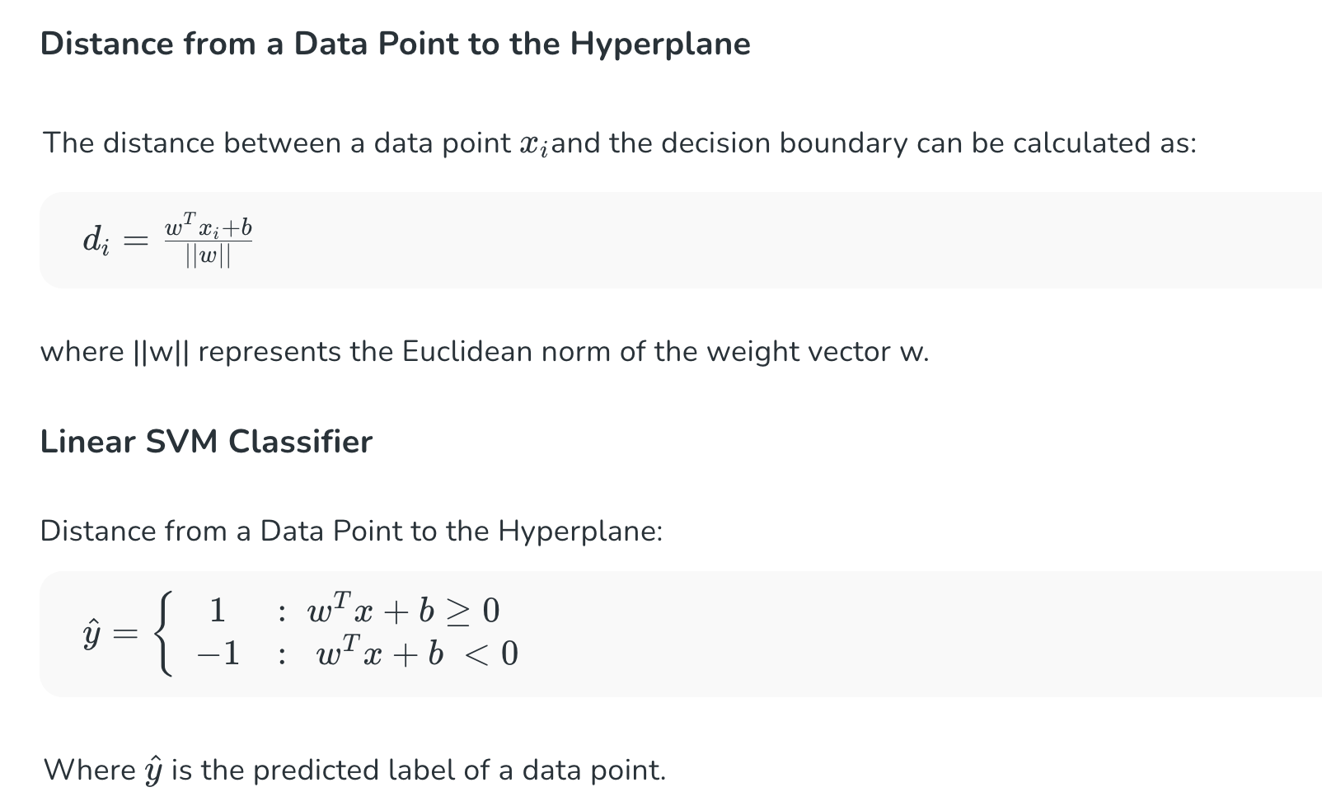
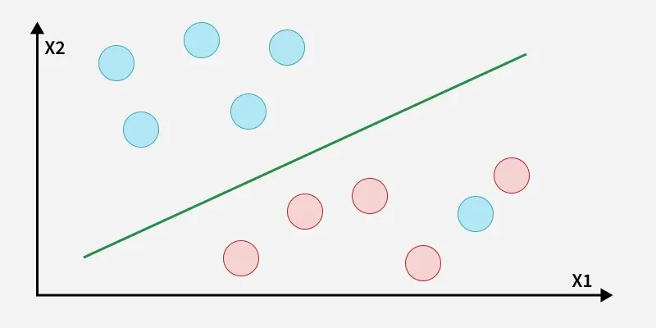
Support Vector Machine (SVM)

Slide 13
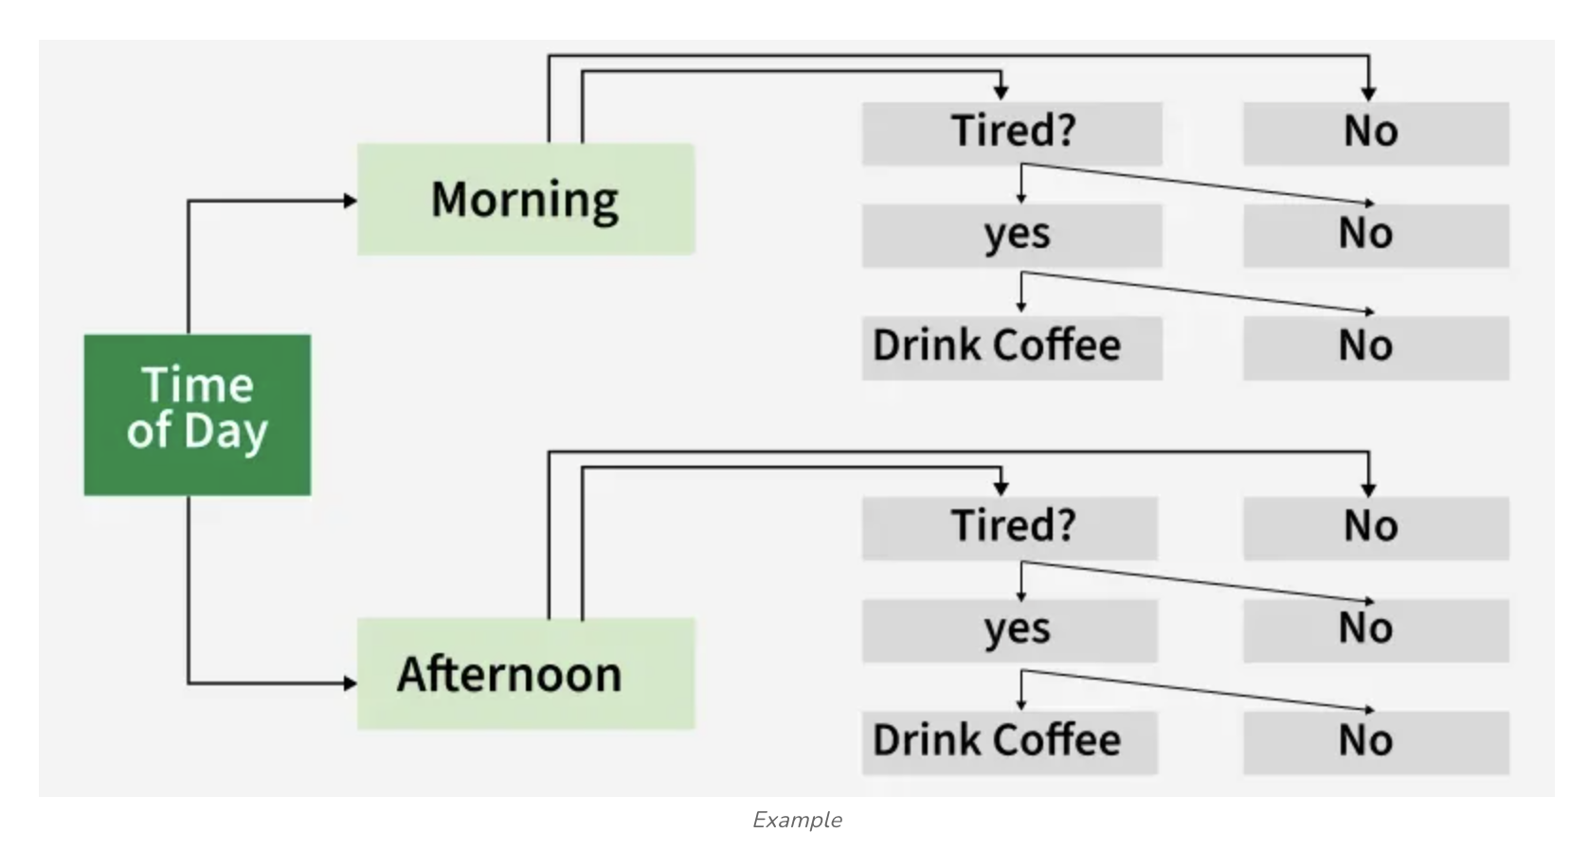
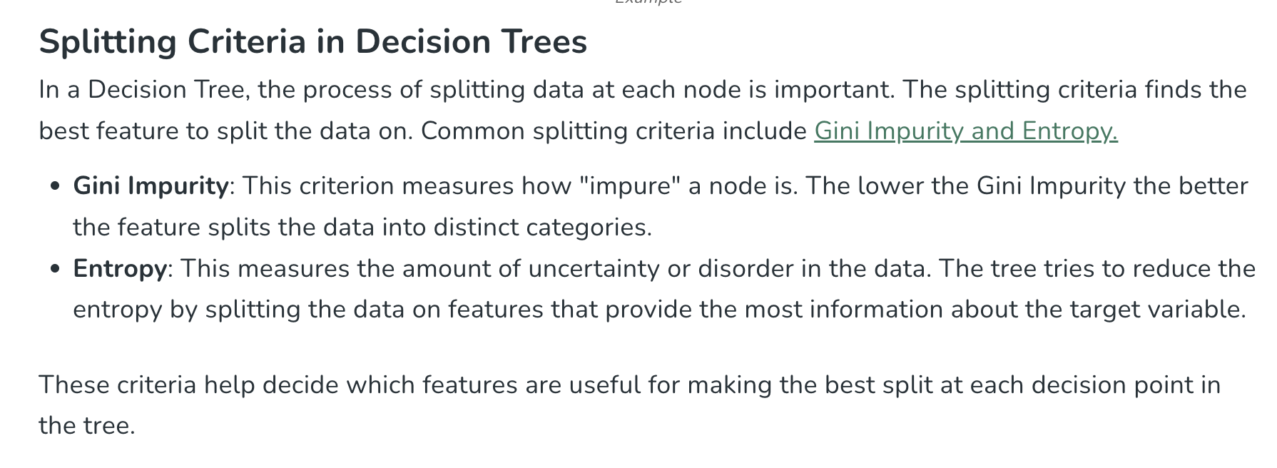
Decision Tree

Slide 14
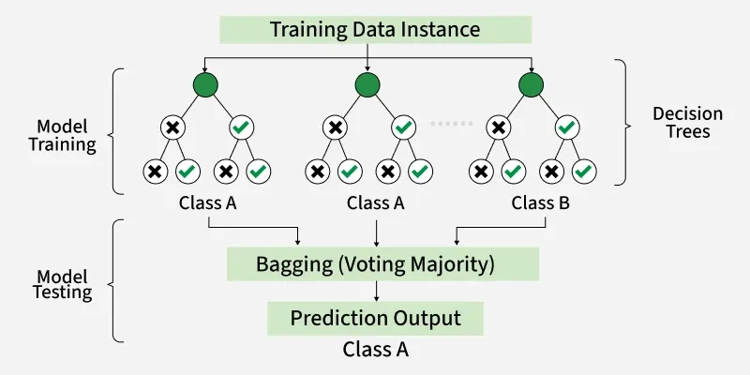
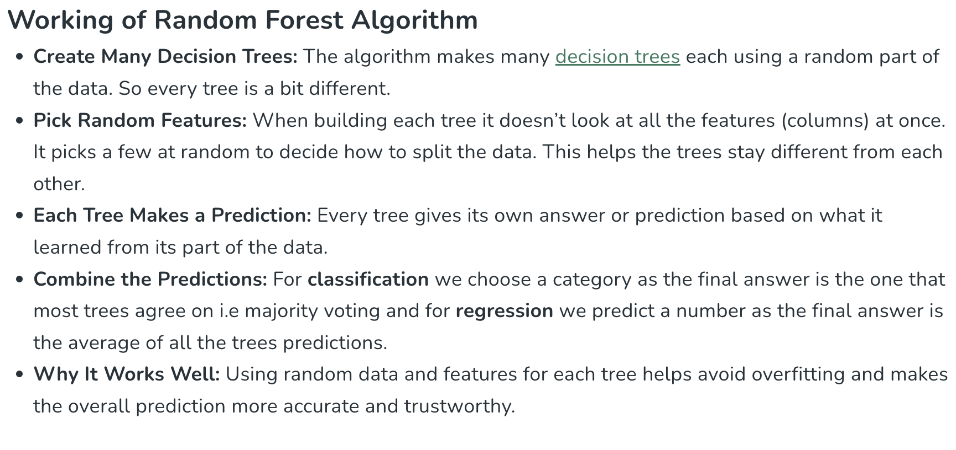
Random Forest

Slide 15
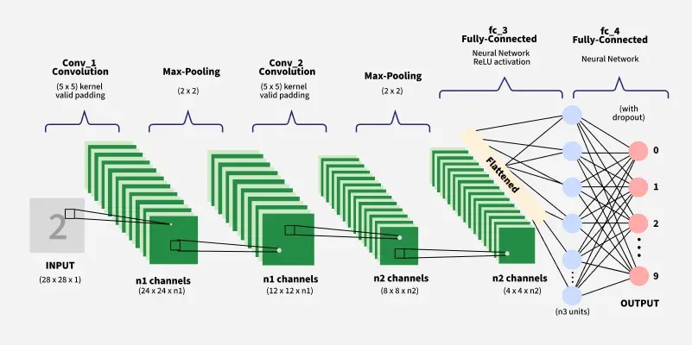
CNN

Slide 16
AI-assisted Binary & Library Fuzzing

Slide 17
Content
How C & C++ code works during execution
Why dynamic detection method as fuzzing matters
How LLMs helps fuzzing
Hands on experiments
Notes:
.
Here is the outline of today’s talk.
First, I’ll briefly explain how C and C++ programs execute, because this directly affects how fuzzing works.
Then I’ll explain why dynamic detection methods, especially fuzzing, are necessary compared to static analysis.
After that, I’ll introduce how large language models can help fuzzing, especially in generating and mutating inputs.
Finally, I’ll show some hands-on experimental results, including coverage improvements on real-world OSS-Fuzz projects.

Slide 18
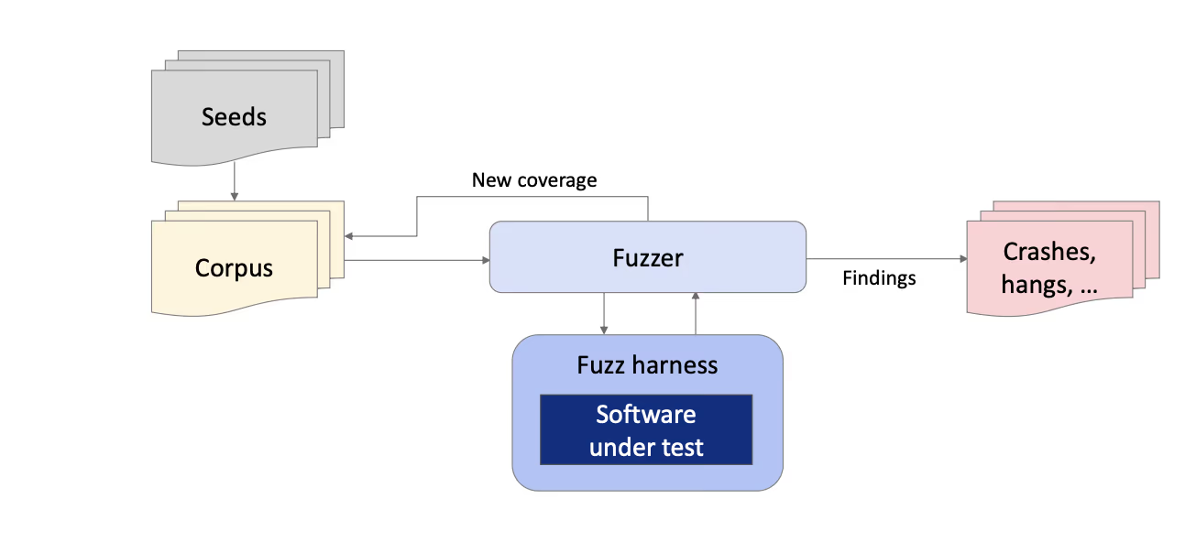
How code works during execution
Fuzzing Workflow Overview
Seeds provide initial valid or semi-valid inputs
→ Serve as starting points for fuzzing
Corpus stores inputs that trigger new behaviors
→ Continuously updated based on coverage feedback
Fuzzer mutates inputs and schedules executions
→ Guided by coverage and runtime feedback
Fuzz Harness connects the fuzzer to the software under test
→ Feeds inputs and observes execution behavior
Findings include crashes, hangs, and abnormal behaviors
→ Indicate potential bugs or vulnerabilities
Notes:
This diagram illustrates the core feedback-driven loop of modern fuzzing.
The process starts with a set of seed inputs, which are typically valid or representative examples of the program’s expected input format. These seeds are placed into a corpus, which acts as the evolving knowledge base of the fuzzer.
The fuzzer repeatedly selects inputs from the corpus and applies various mutation strategies to generate new test cases. Each mutated input is then passed through the fuzz harness, which serves as a wrapper that feeds the input into the software under test and executes the target code in a controlled manner.
During execution, the fuzzer monitors runtime feedback, most importantly code coverage information. If a new input triggers previously unseen execution paths, it is considered valuable and added back into the corpus, enabling the fuzzer to progressively explore deeper and more complex program behaviors.
At the same time, the fuzzer records findings such as crashes, hangs, or memory violations. These findings often correspond to real bugs or security vulnerabilities, making fuzzing an effective dynamic analysis technique for discovering flaws that are difficult to detect with static methods.

Slide 19
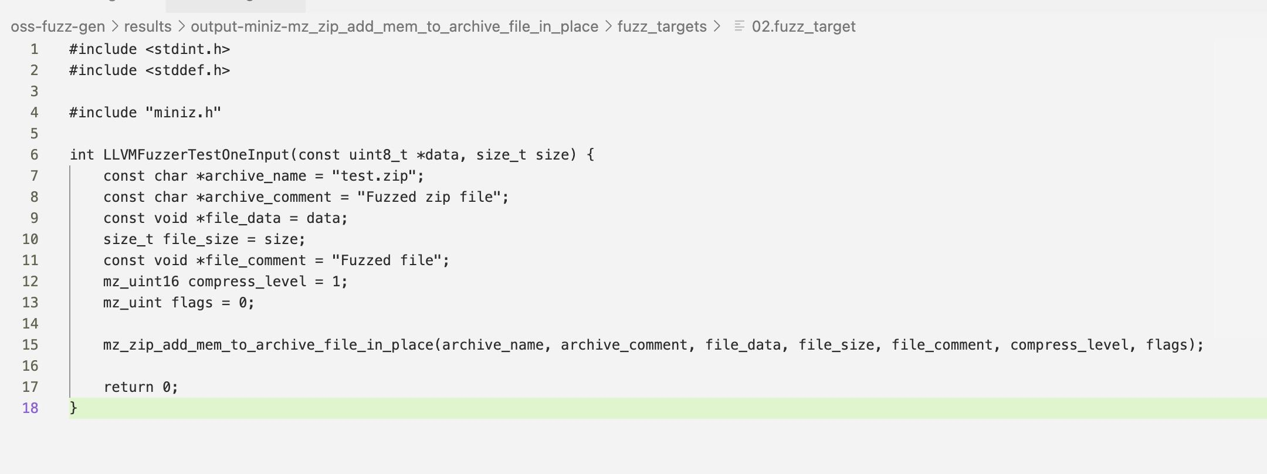
How code works during execution
Given an input (from stdin or harness files)
A harness defines the entry point for the fuzzer
It maps raw fuzzer input to meaningful program inputs
→ data and size are interpreted as file contents
It invokes a specific target API or function
→ mz_zip_add_mem_to_archive_file_in_place(...)
It isolates the test logic from the rest of the application
→ No CLI parsing, no full program execution
Notes:
This code snippet is a typical example of a fuzz harness file used by modern fuzzers such as LibFuzzer or OSS-Fuzz.
The harness defines a special function, LLVMFuzzerTestOneInput, which serves as the entry point that the fuzzer repeatedly calls with mutated inputs.
The parameters data and size represent the raw bytes generated by the fuzzer. The role of the harness is to translate these arbitrary bytes into inputs that the target software can consume. In this example, the fuzzed data is treated as in-memory file content and passed directly to a ZIP-processing API in the miniz library.
Rather than fuzzing an entire application or command-line tool, the harness directly invokes a specific function of interest—mz_zip_add_mem_to_archive_file_in_place. This allows the fuzzer to focus on a well-defined execution path and efficiently explore edge cases inside the library code.
By isolating the target functionality and eliminating unrelated logic such as argument parsing or I/O handling, the harness improves coverage, performance, and crash reproducibility. In practice, the quality of the harness largely determines how effective fuzzing will be at uncovering deep bugs and security vulnerabilities.

Slide 20
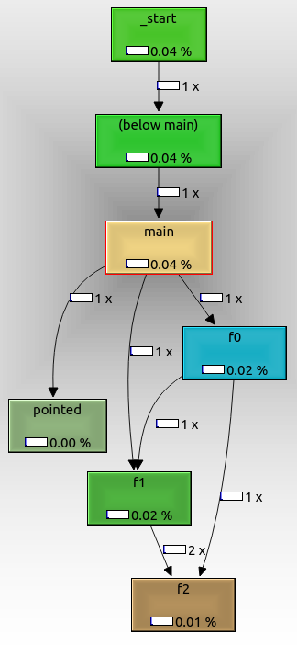
How code works during execution
Given an input (from stdin or harness files)
Run ONE path from main() to somewhere
-- call graph
Nodes represent functions
→ _start, main, f0, f1, f2
Edges represent function calls
→ An edge means “this function may call that function”
Edge labels show call frequency
→ 1×, 2× indicate how many times the call happened
Coverage/color reflects execution frequency or time
→ Helps identify hot and cold functions
Notes:
This diagram is a call graph, which describes how functions call each other during program execution.
Each node represents a function, and each directed edge indicates a possible or observed function call relationship.
Execution starts from the program entry point (_start), flows into main, and then branches into other functions such as f0 and f1. Some functions, like f2, may be called from multiple callers, which is why multiple arrows converge on them.
The numbers on the edges indicate how many times a call occurred, while the colors or percentages show relative execution cost or coverage. Call graphs are useful for understanding high-level program structure, but they do not show what happens inside a function.

Slide 21
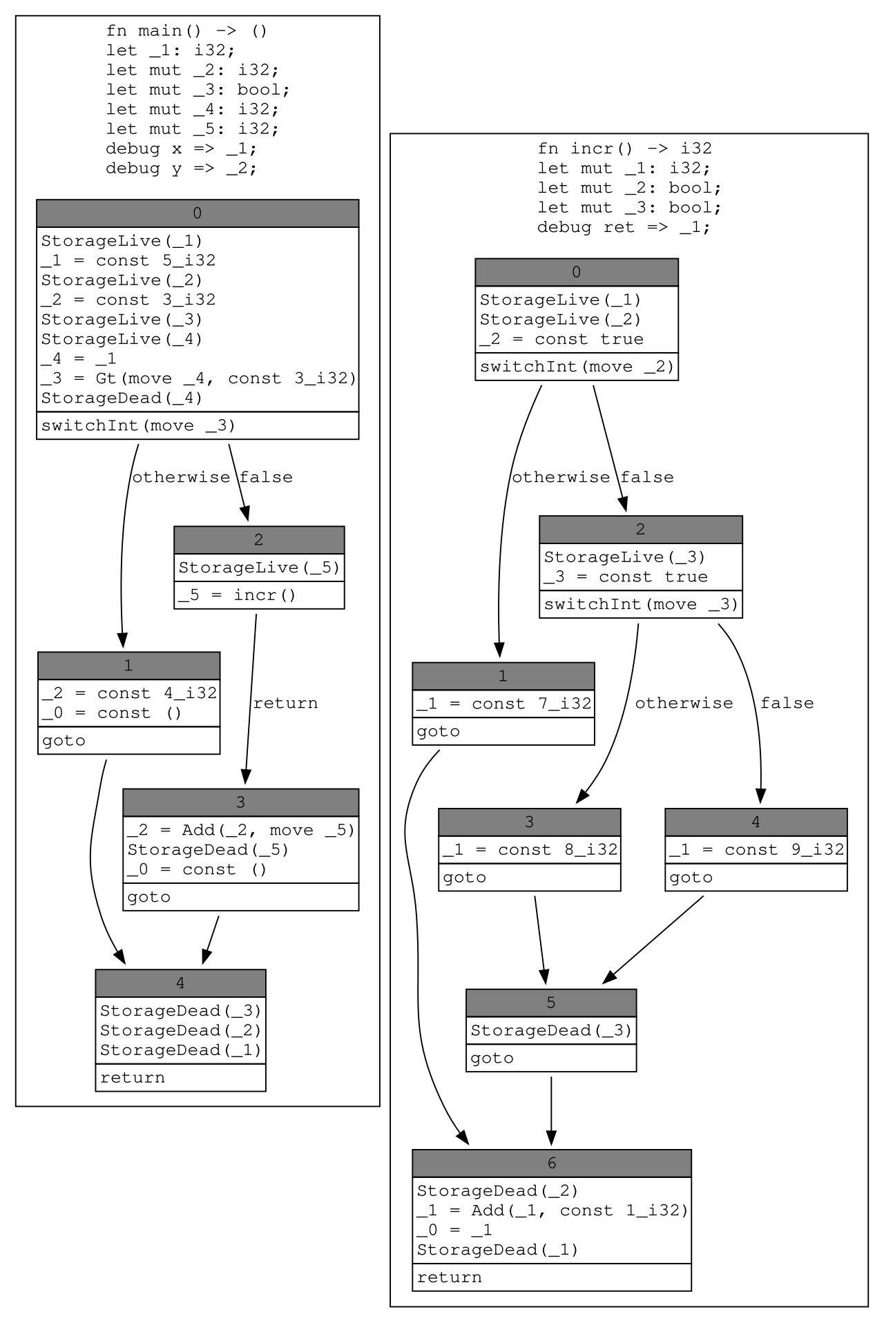
How code works during execution
Given an input (from stdin or harness files)
Run ONE path from main() to somewhere
-- control flow graph
A CFG models execution flow inside a single function
Nodes are Basic Blocks (BBs)
→ Straight-line code with one entry and one exit
Edges represent possible control transfers
→ if, else, switch, goto, return
Branching splits execution into multiple paths
→ Only one path is taken per execution
Notes:
“Now we stop looking at which functions call which.
Instead, we focus on what happens inside a single function, step by step.”
1️⃣ What does a CFG describe?
A Control Flow Graph shows all the possible ways execution can flow inside one function.
In simple terms, it answers the question:
“If the program is at this line, where can it go next?”
The CFG draws all those possible next steps.
2️⃣ What is a Basic Block?
“Each box in the CFG is called a Basic Block.”
A Basic Block is a chunk of code that:
Executes straight from top to bottom
Has no jumps in the middle
Has one entry point
Has one exit point
Once execution enters a basic block, every instruction in it will run.
So remember this:
A Basic Block is a piece of code that always executes together.
3️⃣ Why do we split code into Basic Blocks?
Because real programs contain:
if / else
switch
goto
return
Whenever the program needs to make a decision, the execution can split.
At that point, the CFG cuts the code into separate basic blocks.
Each block represents one uninterrupted execution segment.
4️⃣ What do the arrows mean?
The arrows show where execution may go next after finishing a block.
Conditional statements create multiple outgoing arrows
A goto creates a single forced jump
A return ends the function and has no outgoing arrow
Important point:
The CFG shows all possible paths — not one actual run.
5️⃣ How many paths does one execution take?
Only one.
Even though the CFG looks like a network of many paths,
a single program run follows only one path from start to end.
A good analogy is:
“The CFG is a map.
A program execution is one route on that map.”
6️⃣ Why is CFG important for fuzzing?
This explains a key idea in fuzzing:
One fuzz input
Executes one path in the CFG
Other paths require different inputs
So fuzzing works by:
Generating many inputs to explore new paths in the CFG.
Bugs often hide in paths that are rarely taken.

Slide 22
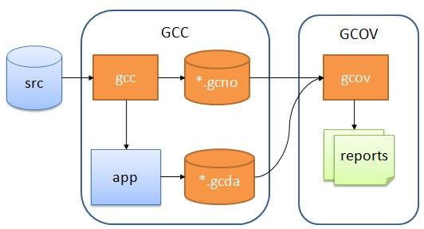
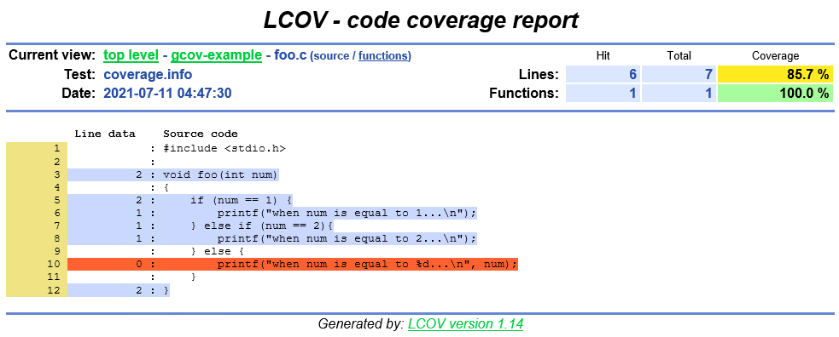
Why dynamic detection method as fuzzing matters
Code coverage
Source code is compiled with coverage instrumentation
→ GCC inserts counters into the program
Compilation produces a static structure file (.gcno)
→ Describes the program’s control-flow structure
Program execution produces runtime data (.gcda)
→ Records which parts of the code actually ran
gcov processes both files to generate coverage data
→ Used to build human-readable reports
Notes:
When we compile a program with GCC using coverage flags, the compiler does not just produce a normal binary.
It instruments the code by inserting counters at important locations, such as basic blocks and branches.
During compilation, GCC generates a file called .gcno.
This file contains the static structure of the program — essentially, where the code could go.
When we run the program, the instrumented binary produces a .gcda file.
This file records what actually happened at runtime — which lines or blocks were executed, and how many times.
Finally, the gcov tool combines the static structure (.gcno) with the runtime data (.gcda) and turns it into coverage information that other tools can visualize. This LCOV report shows which lines of code were executed during the test run.
Each line in the source code is annotated with a number:
A positive number means the line was executed that many times
A zero means the line was never executed
Colors make this very intuitive:
Blue or green lines were covered
Red lines were never reached
At the top, LCOV summarizes coverage using percentages:
Line coverage: how many lines were executed
Function coverage: how many functions were entered
In this example, one branch of the if–else statement was never taken, which means the program logic is only partially tested.

Slide 23
Why dynamic detection method as fuzzing matters
Code coverage
Seed
-- a file (json, xml, ...)
-- a string
-- a number
-- sometimes non-readable
Notes:
.
Fuzzing starts from seeds.
A seed is simply an input to the program. It can be a file like JSON or XML, a string, a number, or sometimes even a binary blob that is not human-readable.
The quality of these seeds matters a lot, because they determine which execution paths we can reach initially.

Slide 24
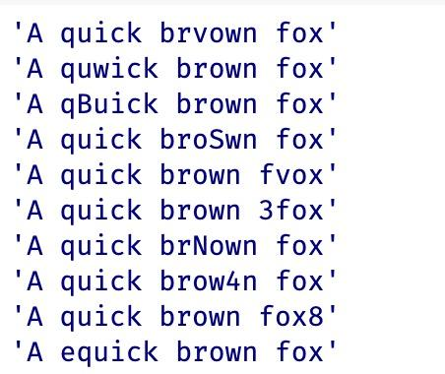
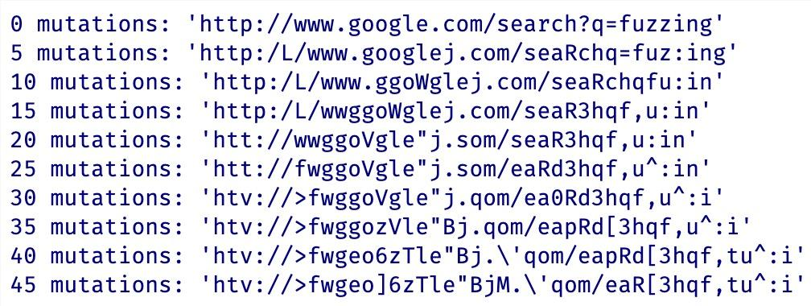
Why dynamic detection method as fuzzing matters
Code coverage
Seed
Scheduling(mutation)
-- byte level
-- token level
-- structure level
-- gramar based
-- semantic mutation
Notes:
.
After we have seeds, fuzzing relies on mutation strategies.
Traditional fuzzers mutate inputs at the byte level, such as flipping bits or bytes.
More advanced fuzzers use token-level or structure-level mutations, and grammar-based fuzzers ensure syntactic validity.
Recently, there is increasing interest in semantic mutation, where we try to change the meaning of the input rather than just its bytes.
This is where LLMs become particularly useful.

Slide 25
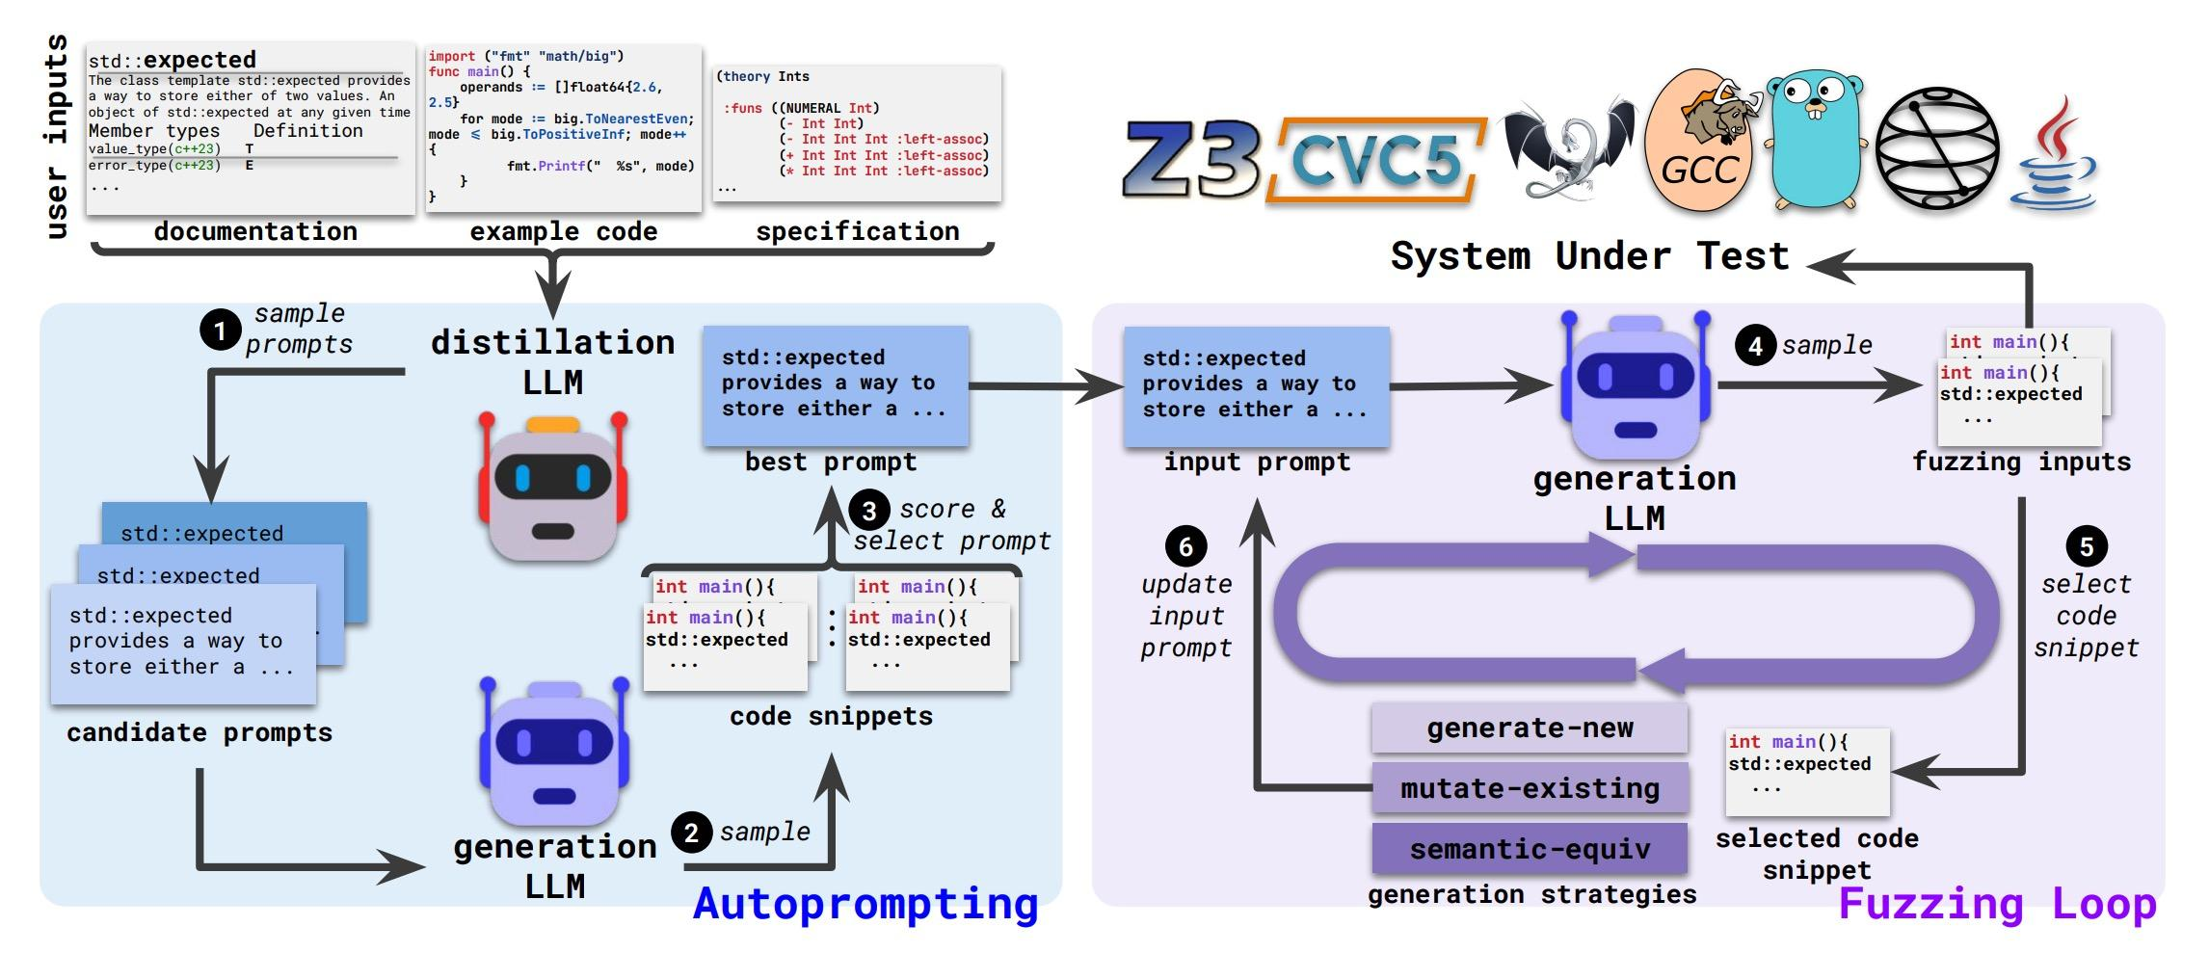
How LLMs helps fuzzing
Notes:
Figure Description: LLM-Driven Autoprompting and Fuzzing Pipeline
This figure presents an end-to-end framework that combines LLM-based autoprompting with a semantic fuzzing loop to test complex software systems, such as compilers, interpreters, and formal verification tools.
At the top of the pipeline, the framework takes heterogeneous user-provided knowledge as input, including documentation (for example, API descriptions of std::expected), example code snippets, and formal specifications. Together, these sources define the semantic scope of the target functionality and serve as the foundation for constructing effective prompts.
The left side of the figure illustrates the autoprompting via distillation process. In this stage, the system samples multiple candidate prompts derived from the available documentation, examples, and specifications. A generation LLM then uses these prompts to produce multiple candidate code snippets, such as small C++ programs exercising the target feature. These generated snippets are evaluated according to criteria such as correctness, diversity, or downstream performance. Based on this evaluation, the system selects the best-performing prompt, effectively distilling a refined input prompt that captures the intended semantics of the target functionality.
The right side of the figure shows a semantic fuzzing loop guided by an LLM and feedback from the system under test (SUT). The refined prompt is fed into a generation LLM, which produces fuzzing inputs in the form of code snippets. A subset of these generated snippets is selected and executed against the SUT, which may include SMT solvers (e.g., Z3 or CVC5), compilers (e.g., GCC), or language runtimes and analysis tools. During execution, results such as failures, crashes, or coverage information are collected and used as feedback. This feedback is then used to update the input prompt, and the process iterates.
Within the fuzzing loop, the framework supports multiple generation strategies. These include generating entirely new programs, mutating existing generated code, and applying semantic-equivalent transformations that produce syntactically different but semantically equivalent inputs. By operating at the semantic level rather than relying solely on low-level syntax mutations, these strategies enable more effective exploration of the input space.
Overall, the figure highlights a closed-loop, LLM-assisted testing framework that automatically distills high-quality prompts from raw knowledge sources, leverages semantic code generation to drive fuzzing, and continuously improves input quality through execution feedback. This design enables semantics-aware fuzzing that goes beyond random mutations and is particularly well suited for testing complex, specification-heavy systems.

Slide 26
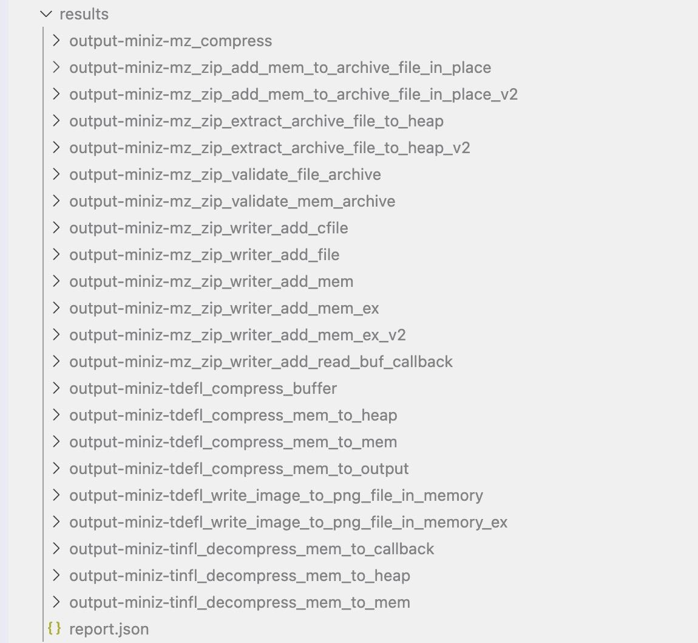
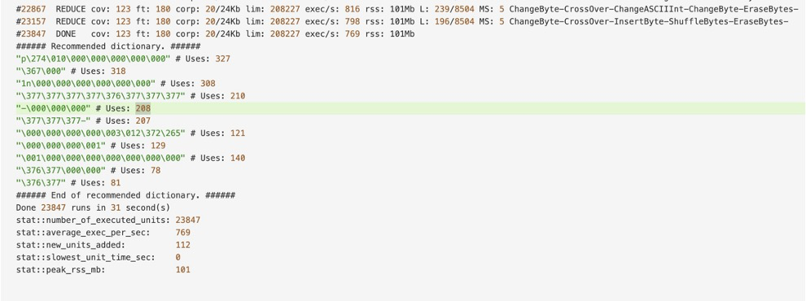
Hands on experiments
OSS-Fuzz-gen
Notes:
.
To evaluate these ideas, we conducted experiments on OSS-Fuzz, which is Google’s large-scale continuous fuzzing infrastructure for open-source software.
We compare the traditional OSS-Fuzz setup with OSS-Fuzz-Gen, which uses LLM-generated fuzzing harnesses and inputs.
This allows us to measure whether LLM assistance can actually improve coverage on real-world projects.

Slide 27
AI-assisted Code Vulnerability Detection

Slide 28

Why do we need Vulnerability Detection
Software vulnerabilities are a major cause of security breaches
Manual code review is time-consuming and error-prone
Rule-based static analysis tools have limited coverage
New vulnerabilities appear faster than rules can be written
Understand how AI detects code vulnerabilities
Run a vulnerability detection model
Analyze model predictions
Reflect on limitations of AI in security
Notes:
Modern software systems are complex and large-scale.
Even experienced developers can introduce vulnerabilities unintentionally.
Traditional tools rely on manually crafted rules, which are hard to maintain and often miss unknown patterns.
This motivates using AI to automatically learn vulnerability patterns from data.

Slide 29
Task Definition
Input: A function-level code representation
Output: Vulnerable (1) or Non-vulnerable (0)
Task Type: Binary classification
Granularity: Function-level vulnerability detection
Dataset: Real-World Vulnerability Data
Source: CVE-based, 150K+ C functions
Split: 5.8% vulnerable, 94.2% safe
Term | Meaning (Chinese) | What It Is | Example | Purpose
CVE ID | Vulnerability Identifier | A unique identifier for a specific vulnerability | CVE-2014-0160 | Track and reference a specific vulnerability
CWE ID | Vulnerability Type | A classification of vulnerability types | CWE-119 (Buffer Overflow) | Identify the category of a vulnerability
CVSS Score | Severity Score | A numerical score (0–10) indicating severity | 9.8 (Critical) | Prioritize vulnerability remediation
Commit Info | Commit Information | Git commit record that fixes the vulnerability | a3f5c8d… | Trace code changes across versions
Patch Details | Patch Details | Specific code modifications in the fix | strcpy → strncpy | Understand how the vulnerability was fixed
Notes:
We frame vulnerability detection as a supervised learning problem.
Each code function is treated as one data sample.
The model predicts whether this function contains a vulnerability or not.
So fundamentally, this is a binary classification task.
Our data comes from the MSR_data_cleaned dataset on HuggingFace, which is built from real-world CVE vulnerability records. It contains actual production code from well-known open-source projects like the Linux kernel, FFmpeg, and Apache.
In terms of scale, we have over 150,000 C language functions in total. Among these, 8,720 functions are vulnerable, accounting for 5.8%, while over 142,000 functions are non-vulnerable, making up 94.2%.
To better understand and label these vulnerable functions, real-world vulnerability records provide essential contextual information.
In vulnerability analysis, each vulnerability is described using standardized identifiers and metadata.
CVE IDs uniquely identify individual vulnerabilities, while CWE IDs categorize them based on underlying weakness types.
The CVSS score quantifies the severity of a vulnerability and helps prioritize remediation efforts.
In addition, commit information and patch details provide insight into how vulnerabilities are fixed at the code level.
Together, these elements form the foundation for understanding, analyzing, and automatically detecting software vulnerabilities using AI-based approaches.

Slide 30
Code Representation
How Is Code Converted into AI Input?
1. Tokenization
• Use CLexer to parse C code into tokens
• Remove comments & string literals
2. Vocabulary Building
• 161,622 unique tokens
• Filter low-frequency tokens (min_freq=5)
3. Sequence Encoding
• Token → Integer IDs
• Fixed length: 300 (padding/truncating)
• Embedding: ID → 128-dim dense vectors
4. Representation Level
• Function-level granularity
• Sequential structure preserved
Notes:
So how do we convert code into something AI can understand?
First, tokenization. We use a C lexer to break down the source code into tokens—things like keywords, operators, and variable names. We also preprocess the code by removing comments and string literals, since they don't affect functionality. For example, a function like 'strcpy(buffer, input)' becomes a sequence of tokens: 'strcpy', opening parenthesis, 'buffer', comma, 'input', closing parenthesis.
Second, vocabulary building. Across all 150,000 functions, we identified over 161,000 unique tokens. To reduce noise, we filtered out tokens that appear fewer than 5 times.
Third, encoding. Each token is converted to an integer ID. Then we standardize the sequence length to 300 tokens—longer functions are truncated, shorter ones are padded with zeros.
Finally, embedding. These integer IDs are transformed into 128-dimensional dense vectors through an embedding layer. This captures semantic relationships between tokens—similar code patterns get similar vector representations.
The key point is: we preserve the sequential structure of the code while converting it into a numerical format the neural network can process."

Slide 31
Model Architecture
Why Bi-LSTM + Attention?
1. Why Sequence Models?
• Code has syntactic order (like natural language)
• Dependencies between statements
• Vulnerability patterns span multiple lines
2. Why Bi-LSTM?
• Forward pass: understand what comes before
• Backward pass: understand what comes after
• Example: Variable usage requires both definition & usage context
3. Why Attention? ⭐
• Not all code tokens are equally important
• Focus on vulnerability-critical patterns
• Automatically weight relevant tokens
4. NLP Analogy
• Code = Structured language
• Tokens = Words
• Functions = Sentences/Paragraphs
Notes:
"Our model is a Bi-LSTM with attention. Let me explain why.
Bi-LSTM: We read code in both directions—forward and backward—because vulnerabilities depend on context from both sides. For example, understanding a pointer requires knowing where it's allocated AND where it's freed.
Attention mechanism: Not all code is equally important. Some keywords like 'strcpy' are high-risk, while others like semicolons don't matter much. Attention automatically learns to focus on the critical parts—the vulnerability hotspots.
The architecture is: embedding layer, bidirectional LSTM, attention, dense layer with dropout, and sigmoid output for binary classification.
It's like teaching the model to review code the way a security expert would—scanning both ways and focusing on the dangerous patterns."

Slide 32
Hands-on Task
Task 1: Explore the Dataset
Task 2: Train the Model
Task 3: Make Predictions
Task 1: Explore the Dataset
Inspect input features
Understand labels
Observe data imbalance
Task 2: Train the Model
Run training cells
Observe loss and accuracy
Compare train vs validation
Task 3: Make Predictions
Test on unseen samples

Slide 33
End
Notes:
To conclude, fuzzing is fundamentally about exploring program behaviors, and dynamic execution is essential for that.
Large language models provide a new way to guide this exploration by generating and mutating inputs at the semantic level.
Our experiments show that this approach can lead to meaningful coverage improvements on real-world codebases.
Thank you for your attention. I’m happy to take any questions.

